Slide 1
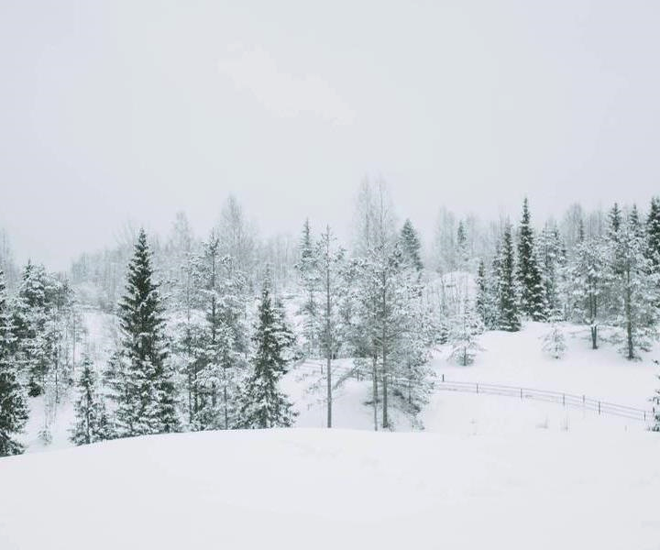
SNOW IN THE BIBLE

Slide 2
SNOW
Leprosy (Ex. 4:6; Num. 12:10; II Kings 5:27)
Forgiveness (Ps. 51:1-7; Is. 1:18)
Effectiveness of God’s word (Is. 55:6-11)
Test of preparation (Prov. 31:21)
God’s glory (Dan. 7:9; Mt. 28:3; Rev. 1:14)
Don’t forget God (Jer. 18:13-17)
Annual revenue growth

